Slide 1
Deep Learning for Econometrics
Greg Lewis (MSR + NBER) Matt Taddy (MSR + Chicago)
Jason Hartford (UBC) Kevin Leyton-Brown (UBC)
Kui Tang (Columbia) Dave Blei (Columbia)
Matt Goldman (MSFT) Justin Rao (MSR) Di Wang (MSFT)
James Zou (Stanford) Mengting Wan (UCSD) Richard Li (UW)

Slide 2
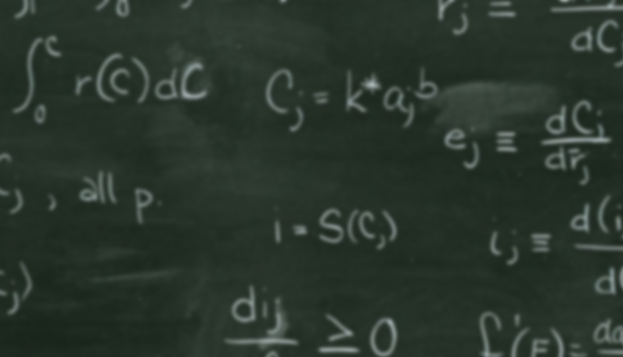
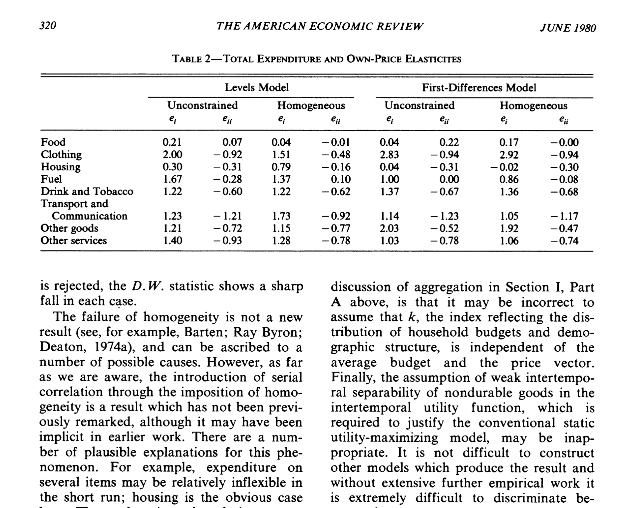
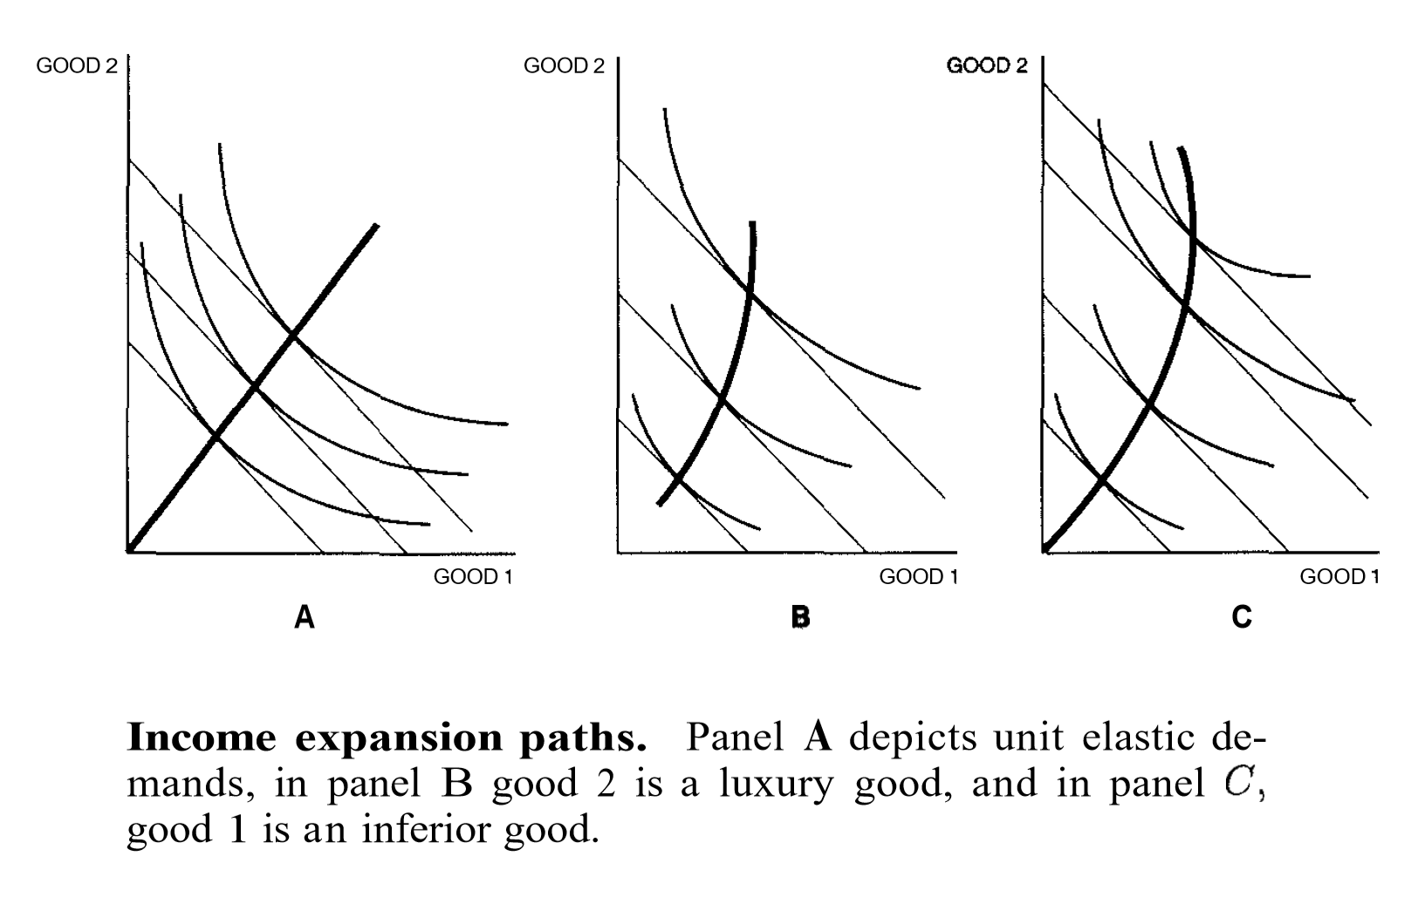
What do economists do?

Slide 3
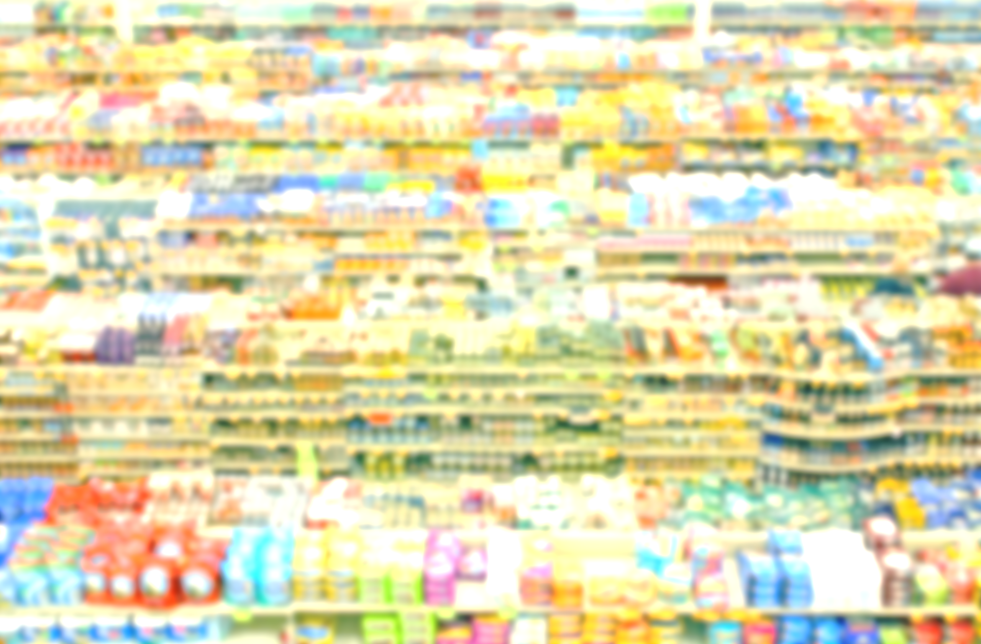
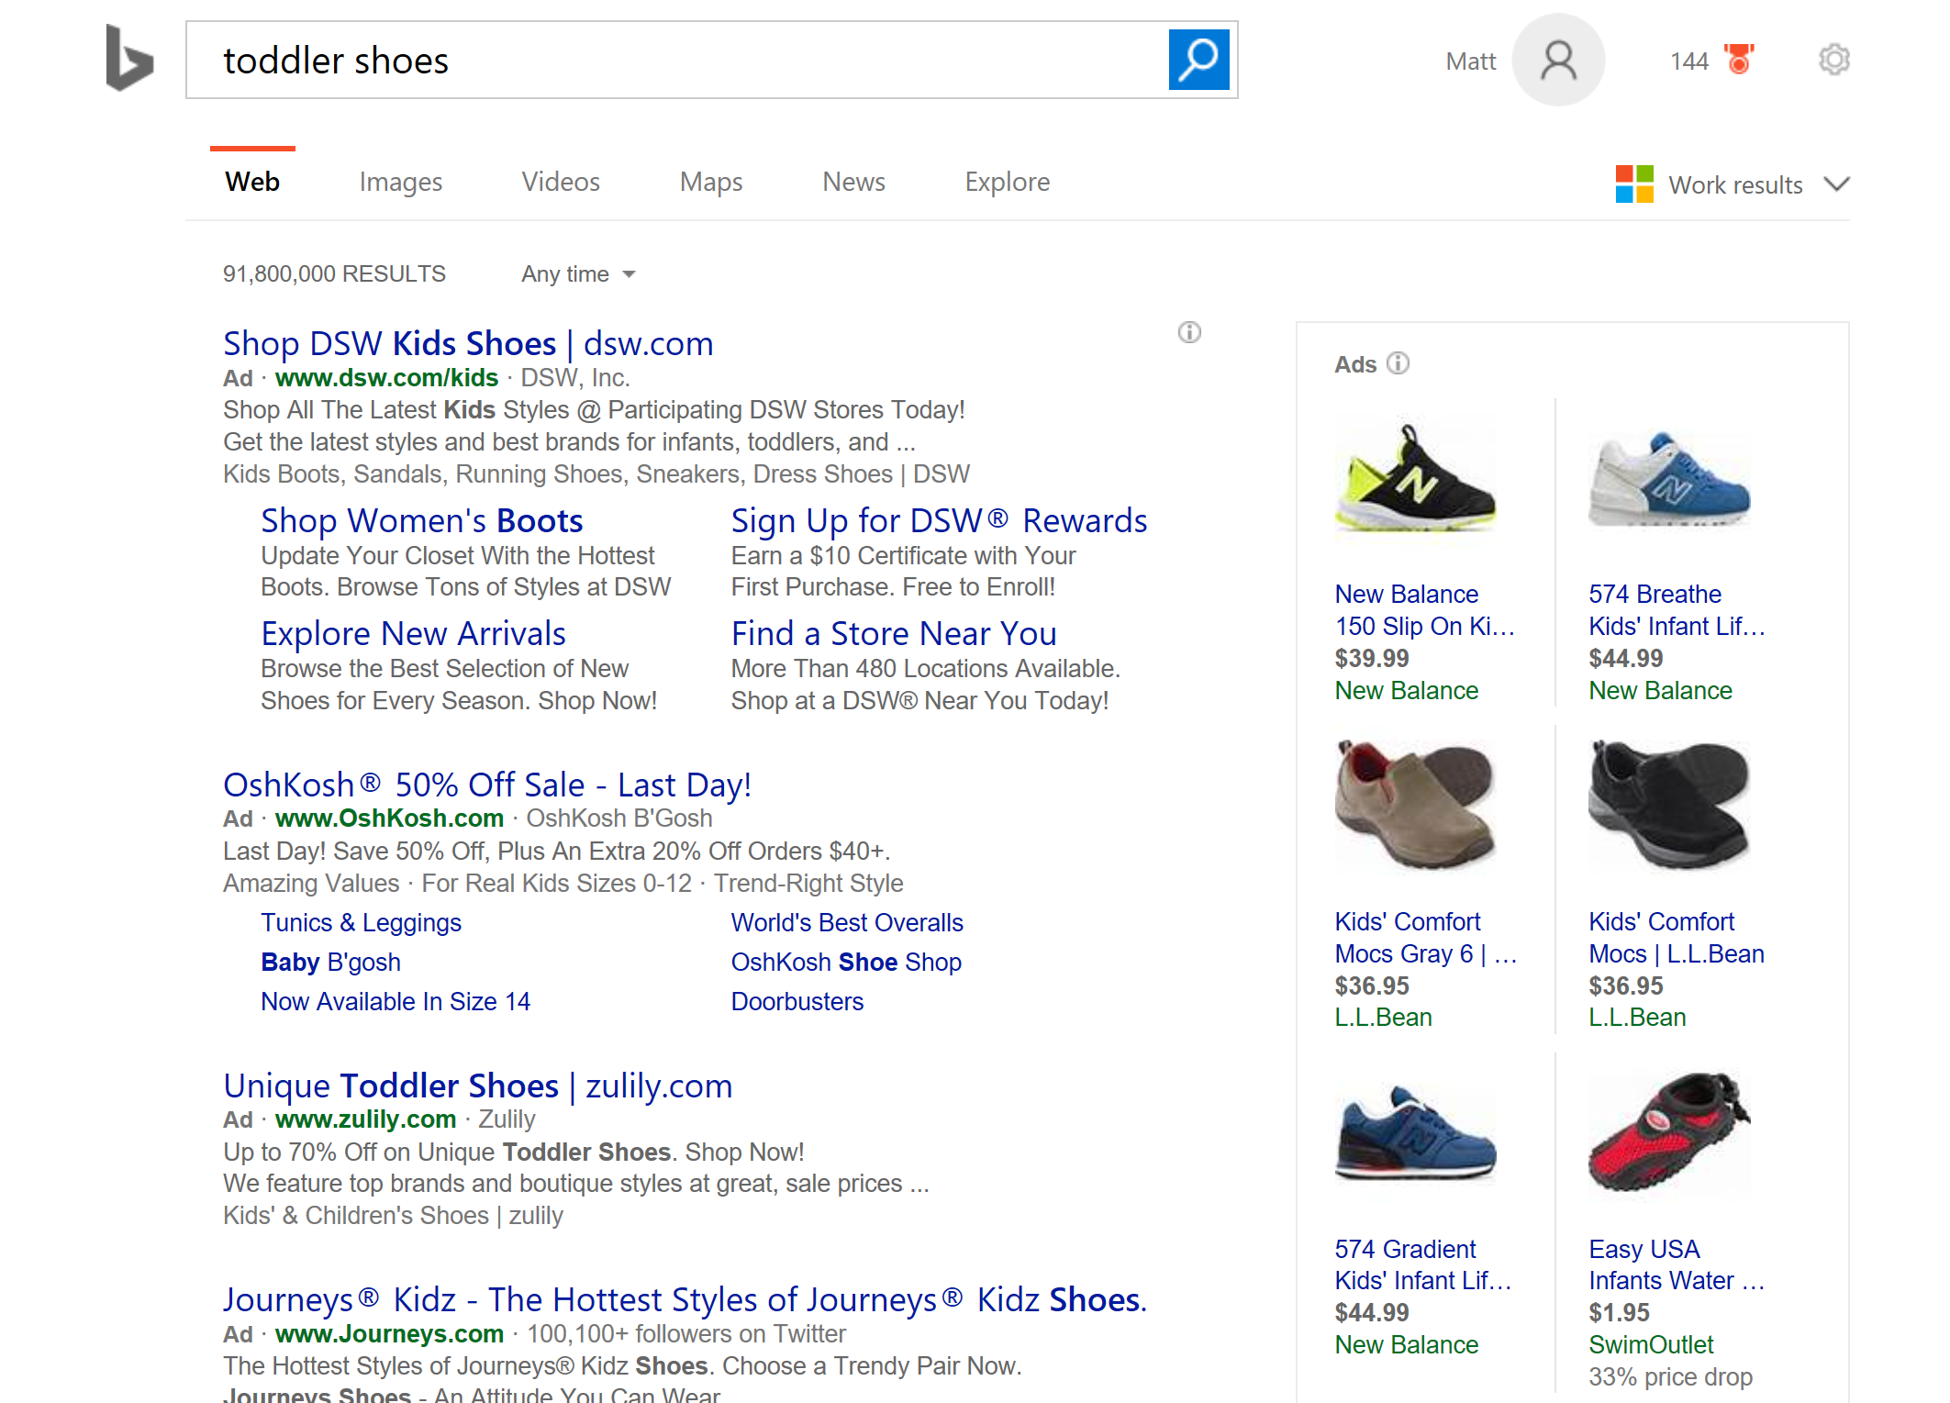

What do they need to do today?

Slide 4
What can we (AI) do to help?
The dimension of the economist’s problem space has exploded
We can develop ML to navigate this space: stay safe and automate
We can also build new econometrics via deep structure

Slide 5
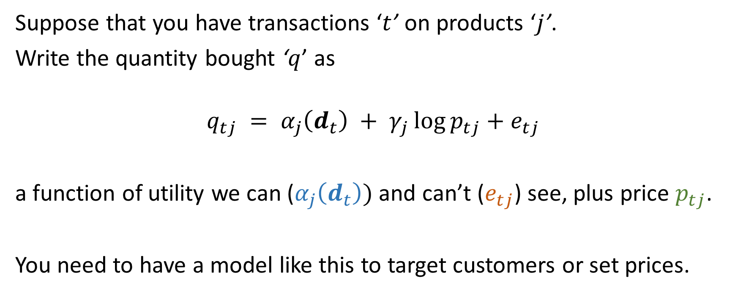
Example: Demand System
Suppose that you have transactions ‘$t$’ on products ‘$j$’.
Write the quantity bought ‘$q$’ as
$$q_{tj} = α_{j}\left(d_{t}\right) + γ_{j}\log{p_{tj}}+e_{tj}$$
a function of utility we can ($α_{j}\left(d_{t}\right))$ and can’t ($e_{tj}$) see, plus price $p_{tj}$.
You need to have a model like this to target customers or set prices.

Slide 6
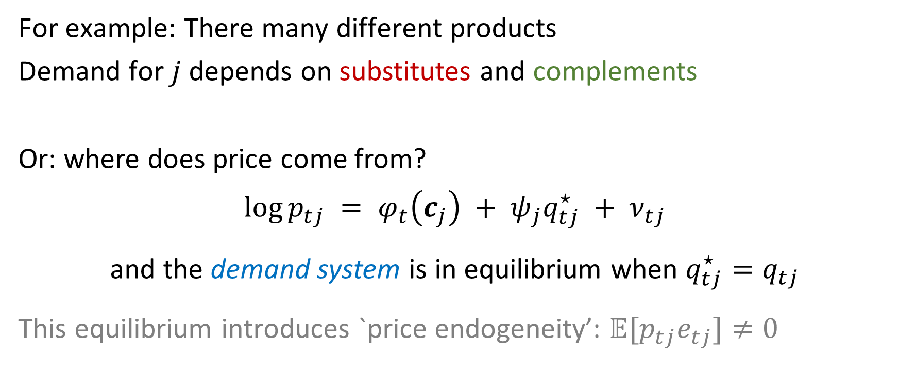
But it’s a system!
For example: There many different products
Demand for $j$ depends on substitutes and complements
Or: where does price come from?
$$\log{p_{tj}} = φ_{t}\left(c_{j}\right) + ψ_{j}q_{tj}^{⋆} + ν_{tj}$$
and the demand system is in equilibrium when $q_{tj}^{⋆}=q_{tj}$
This equilibrium introduces `price endogeneity’: $𝔼[p_{tj}e_{tj}]≠0$

Slide 7
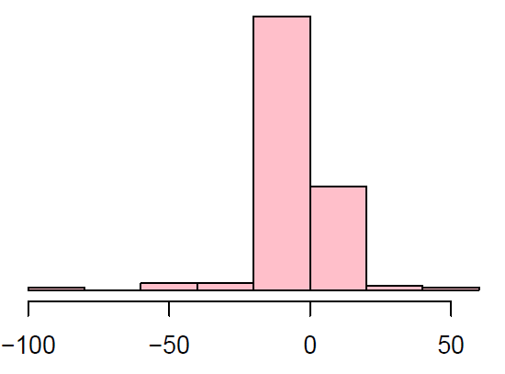
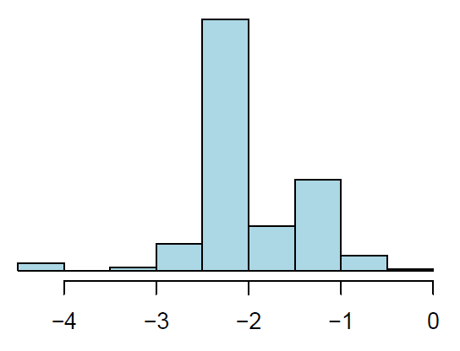

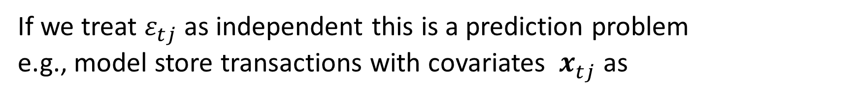
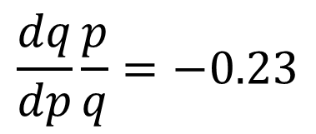
Sometimes it’s just regression
If we treat $ε_{tj}$ as independent this is a prediction problem
e.g., model store transactions with covariates ${ x}_{tj}^{ }$ as
$$𝔼\log{q_{tj}} ={ x}_{tj}^{′}β +\log{p_{tj}}x_{tj}^{′}γ$$
Elasticities:
one shared: $x_{tj}=1$ brand-specific: $x_{tjk}= 𝟙_{\left[k=j\right]}$ $x_{tj}^{ }$= featurized description
$$\frac{dq}{dp}\frac{p}{q}=−0.23$$

Slide 8
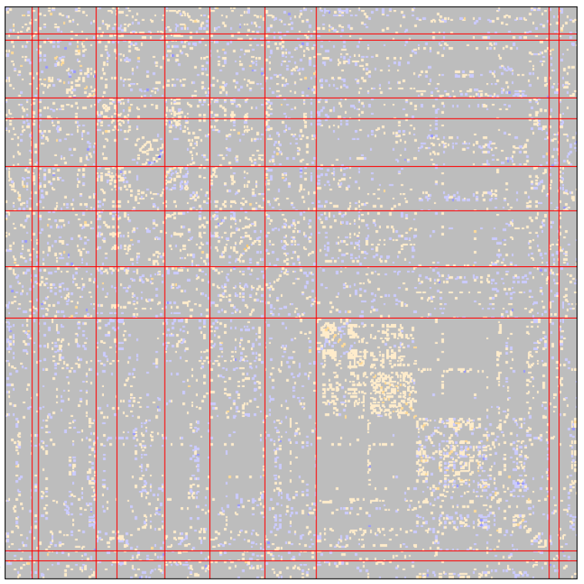
Cross-Product Sales Effects
fitted precision matrix
Products move together
We can fit a graph of conditional
dependencies (i.e., the precision)
as a function of distance in both
observables and latent space.
(using roll-outs for identification)

Slide 9
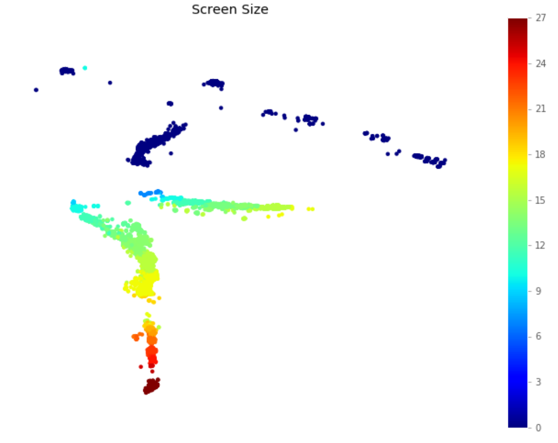
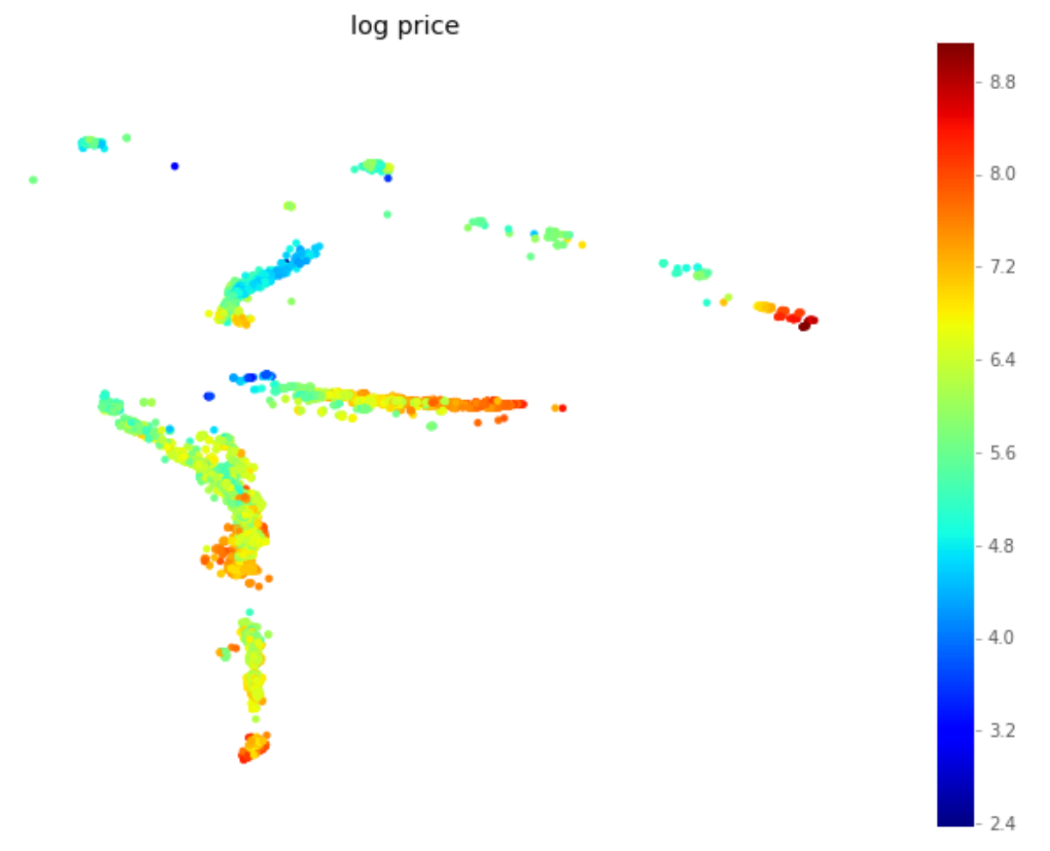
Deep Hedonics
Hedonic regression models prices from product characteristics
If the characteristic space is continuous and low-D then you can invert this to get demand for characteristics
We use auto-encoders to learn low-D latent characteristics

Slide 10
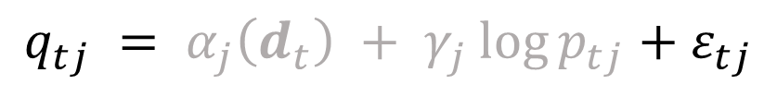
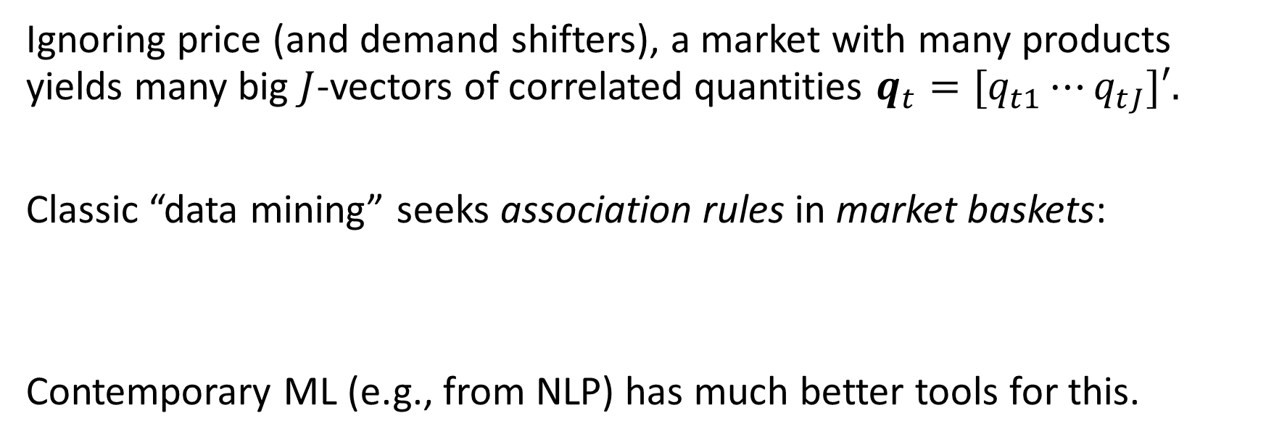

Product Co-occurrence
$$q_{tj} = α_{j}\left(d_{t}\right) + γ_{j}\log{p_{tj}}+ε_{tj}$$
Ignoring price (and demand shifters), a market with many products yields many big $J$-vectors of correlated quantities ${q_{t}=[q}_{t1}⋯q_{tJ}]′.$
Classic “data mining” seeks association rules in market baskets:
Contemporary ML (e.g., from NLP) has much better tools for this.
Find $j≠k$pairs so that $𝔼\left[q_{tj}q_{tk}\right]≫𝔼q_{tj}𝔼q_{tk}$

Slide 11
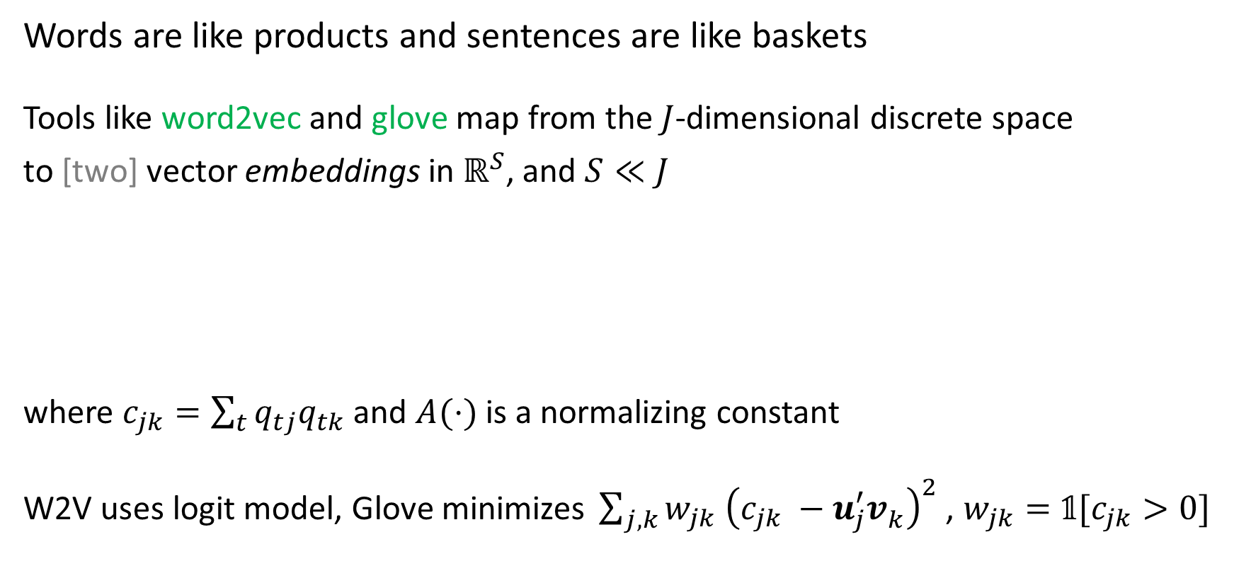

From word to product embedding
Words are like products and sentences are like baskets
Tools like word2vec and glove map from the $J$-dimensional discrete space
to [two] vector embeddings in $ℝ^{S}$, and $S≪J$
where $c_{jk}=\sum_{t}{q_{tj}q_{tk}}$ and $A(⋅)$ is a normalizing constant
W2V uses logit model, Glove minimizes${\sum_{j,k}{w_{jk} {\left(c_{jk} −u_{j}^{′}v_{k}^{ }\right)}^{2}}}$, $w_{jk}=𝟙[c_{jk}>0]$
$$\max\left\{ \sum_{t}{\sum_{j,k}{q_{tj}q_{tk}u_{j}^{′}v_{k}^{ } }} − A\left(U,V,C\right)\right\}$$

Slide 12
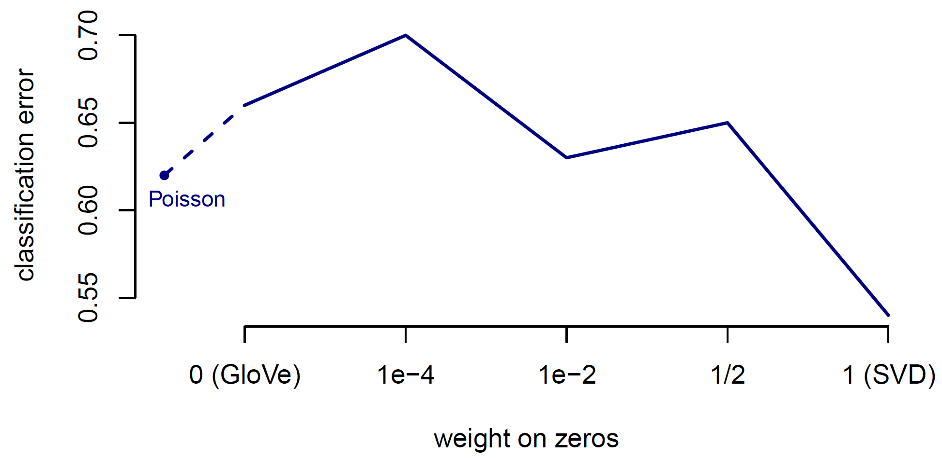
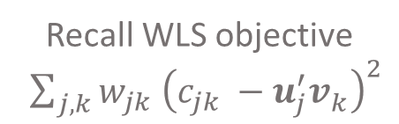
Supermarkets products are organized into narrowly defined modules
If we believe that modules contain mostly substitutes, then
same-space embedding neighbors should often be in the same module
1-Nearest Neighbor Module Prediction
Recall WLS objective ${\sum_{j,k}{w_{jk} {\left(c_{jk} −u_{j}^{′}v_{k}^{ }\right)}^{2}}}$

Slide 13
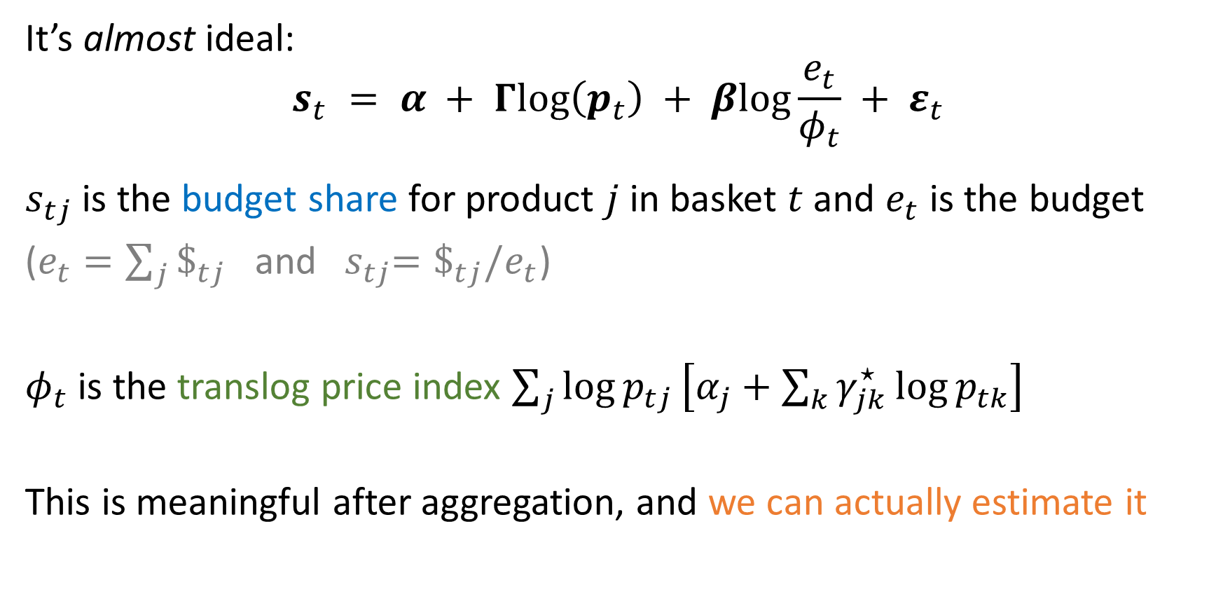
Moving inside a demand system (AID)
It’s almost ideal:
$$s_{t} = α + Γlog\left(p_{t}\right) + βlog\frac{e_{t}}{φ_{t}} + ε_{t}$$
$s_{tj}$ is the budget share for product $j$ in basket $t$ and $e_{t}$ is the budget
($e_{t}=\sum_{j}{\$_{tj}}$ and ${ s}_{tj}=\$_{tj}/e_{t}$)
$φ_{t}$ is the translog price index $\sum_{j}{\log{p_{tj}}\left[α_{j}+\sum_{k}{γ_{jk}^{⋆}\log{p_{tk}}}\right]}$
This is meaningful after aggregation, and we can actually estimate it

Slide 14
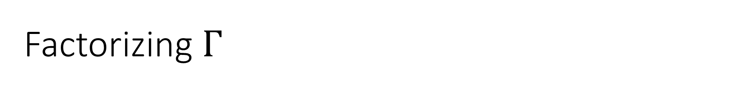
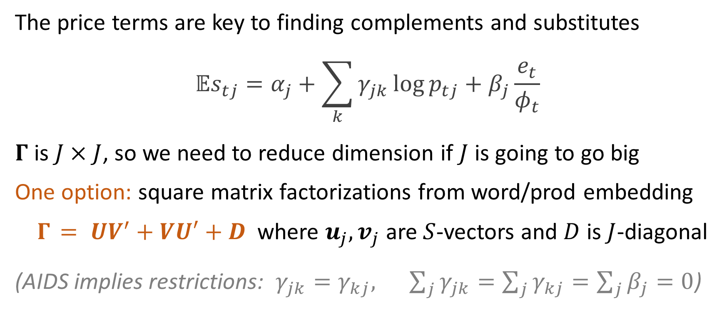
Factorizing $Γ$
The price terms are key to finding complements and substitutes
$${𝔼s}_{tj}=α_{j}+\sum_{k}{γ_{jk}\log{p_{tj}}}+β_{j}\frac{e_{t}}{φ_{t}}$$
$Γ$ is $J×J$, so we need to reduce dimension if $J$ is going to go big
One option: square matrix factorizations from word/prod embedding
$Γ_{ }= UV^{′}+VU′+D$ where $u_{j},v_{j}$ are $S$-vectors and $D$ is $J$-diagonal
(AIDS implies restrictions: $γ_{jk}=γ_{kj}, \sum_{j}{γ_{jk}=\sum_{j}{γ_{kj}}=\sum_{j}{β_{j}=0}}$)

Slide 15
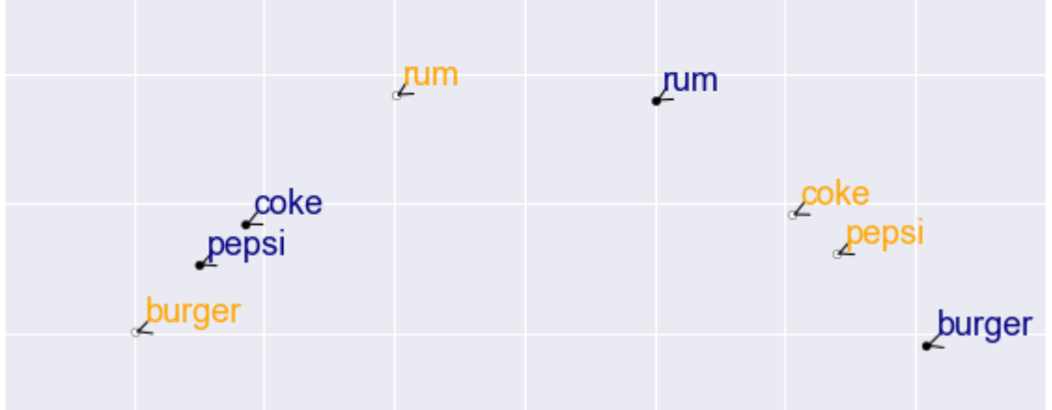
Product Embeddings
substitutes (synonyms) are close in the same vector space
complements (topical words) are close across vector spaces

Slide 16
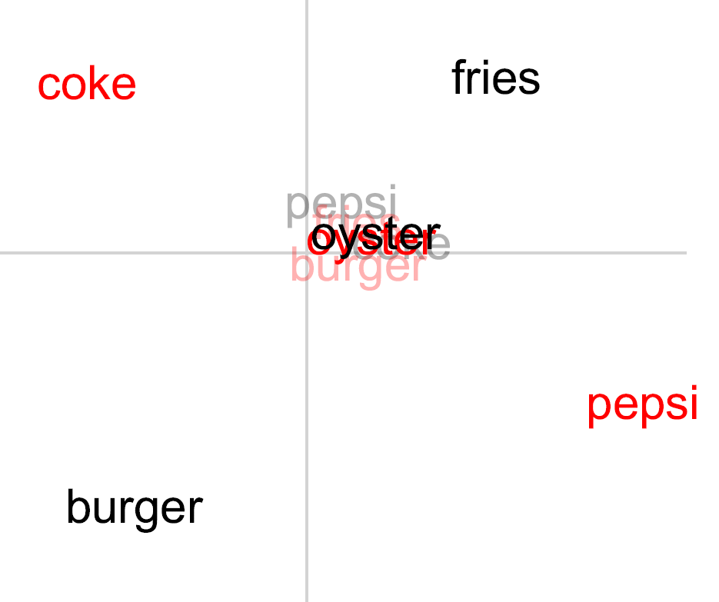
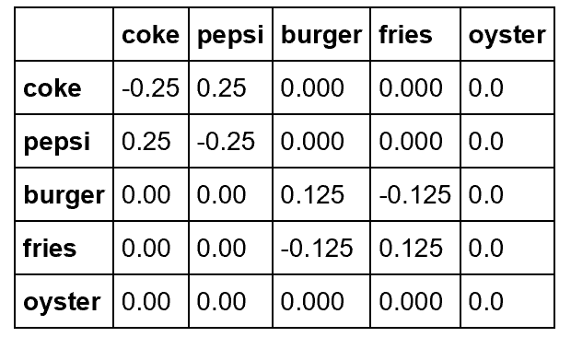
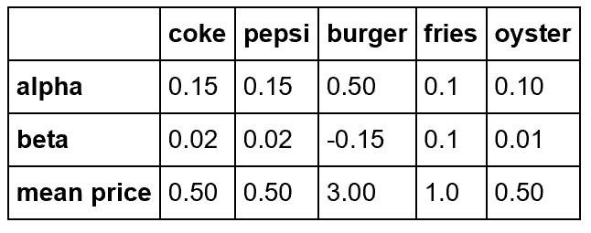
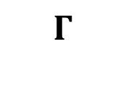
Embedding lunch on the cape
$$Γ$$

Slide 17
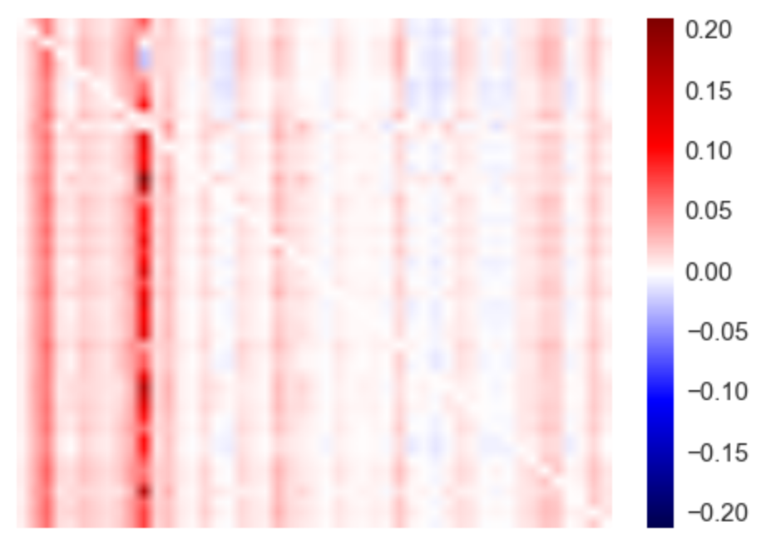



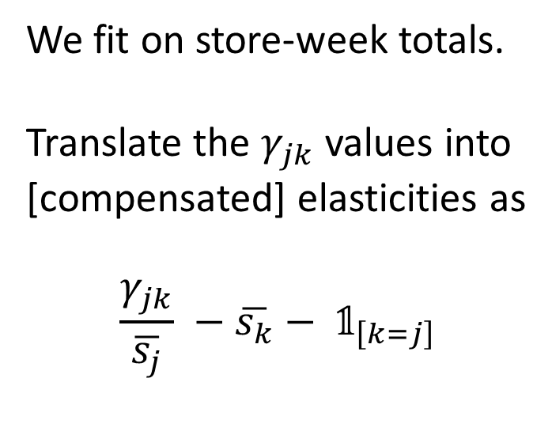
Beer
Elasticity matrix (omitting diagonal)
We fit on store-week totals.
Translate the $γ_{jk}$ values into
[compensated] elasticities as
$$\frac{γ_{jk}}{\overline{s_{j}}} −\overline{s_{k}}− 𝟙_{\left[k=j\right]}$$

Slide 18
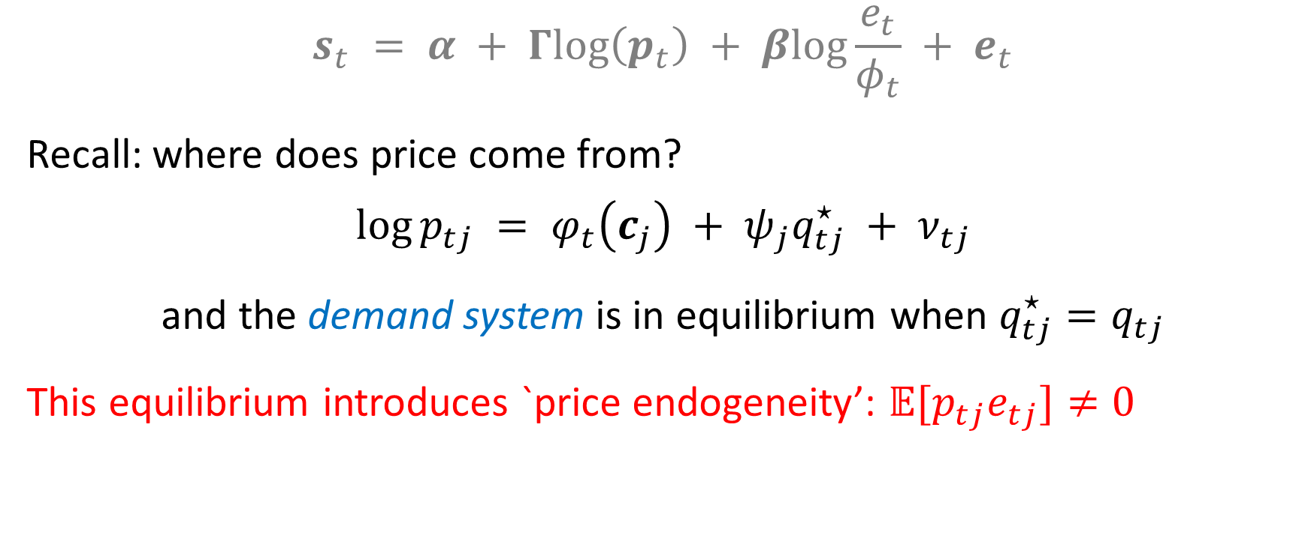
But wait… it’s still a system
$$s_{t} = α + Γlog\left(p_{t}\right) + βlog\frac{e_{t}}{φ_{t}} + e_{t}$$
Recall: where does price come from?
$$\log{p_{tj}} = φ_{t}\left(c_{j}\right) + ψ_{j}q_{tj}^{⋆} + ν_{tj}$$
and the demand system is in equilibrium when $q_{tj}^{⋆}=q_{tj}$
This equilibrium introduces `price endogeneity’: $𝔼[p_{tj}e_{tj}]≠0$

Slide 19
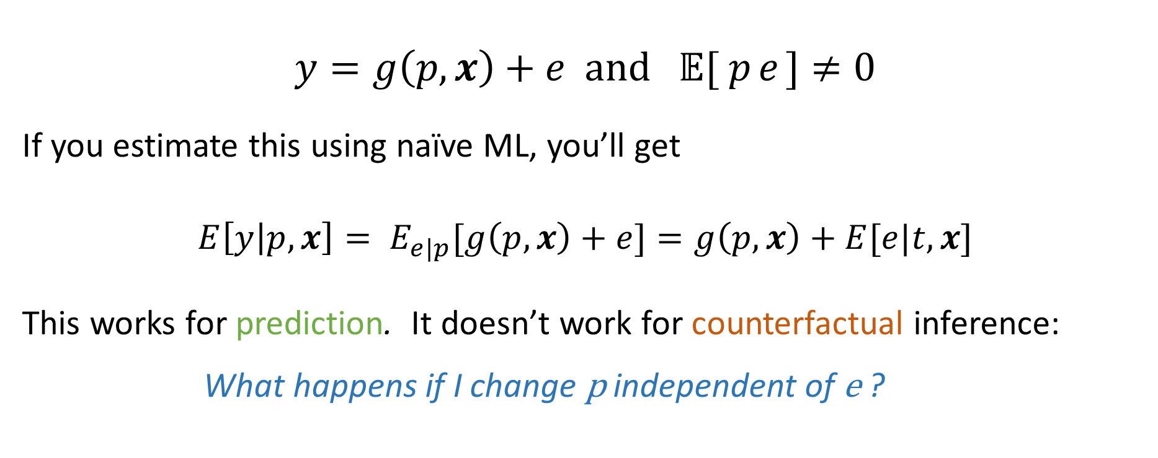
Endogenous Errors
$$y=g\left(p,x\right)+e and 𝔼[{ p}_{ }e_{ }]≠0$$
If you estimate this using naïve ML, you’ll get
$$E\left[y | p,x\right]= E_{e|p}[g\left(p,x\right)+e]=g\left(p,x\right)+E[e|t,x]$$
This works for prediction. It doesn’t work for counterfactual inference:
What happens if I change p independent of e ?

Slide 21
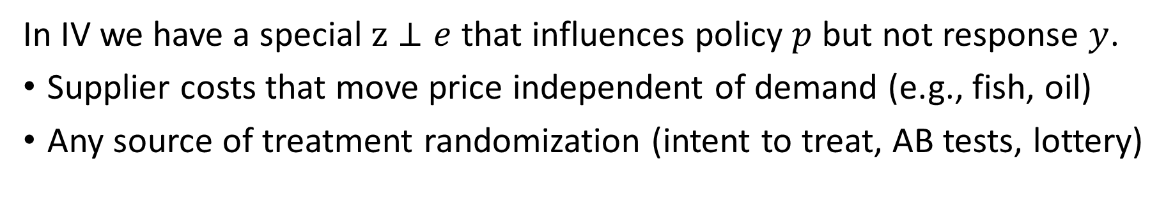
Instrumental Variables (IV)
y
p
x
z
e
In IV we have a special $z⊥e$ that influences policy $p$ but not response $y$.
Supplier costs that move price independent of demand (e.g., fish, oil)
Any source of treatment randomization (intent to treat, AB tests, lottery)

Slide 22
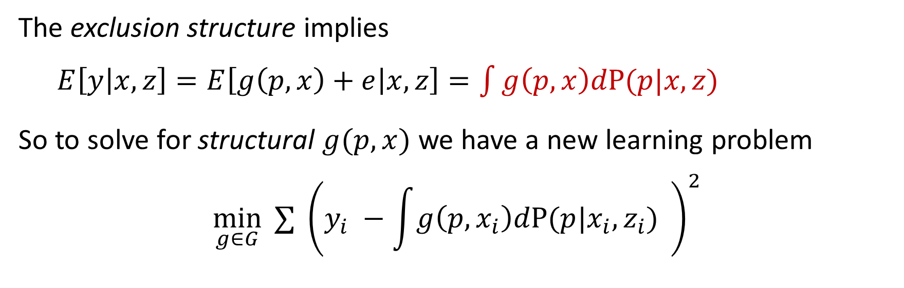
Instrumental Variables (IV)
y
p
x
z
e
The exclusion structure implies
$E\left[y | x,z\right]=E\left[g\left(p,x\right)+e | x,z\right]=\int{g\left(p,x\right)dP(p|x,z)}$
So to solve for structural $g(p,x)$ we have a new learning problem
$$\min_{g∈G}{ ∑} {\left(y_{i} −\int{g\left(p,x_{i}\right)dP(p|x_{i},z_{i})} \right)}^{2}$$

Slide 23
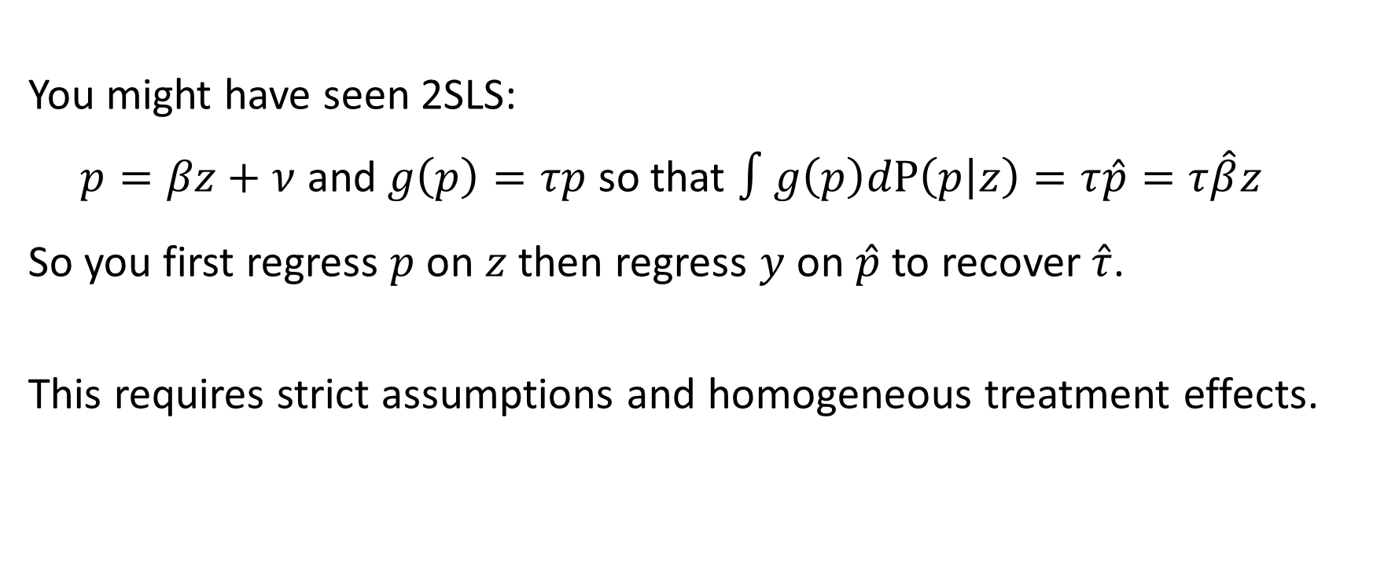

$$\min_{g∈G}{ ∑} {\left(y_{i} −\int{g\left(p,x_{i}\right)dP(p|x_{i},z_{i})} \right)}^{2}$$
You might have seen 2SLS:
$p=βz+ν$ and $g\left(p\right)=τp$ so that $∫g\left(p\right)dP\left(p | z\right)=τ\hat{p}=τ\hat{β}z$
So you first regress $p$ on $z$ then regress $y$ on $\hat{p}$ to recover $\hat{τ}$.
This requires strict assumptions and homogeneous treatment effects.

Slide 24
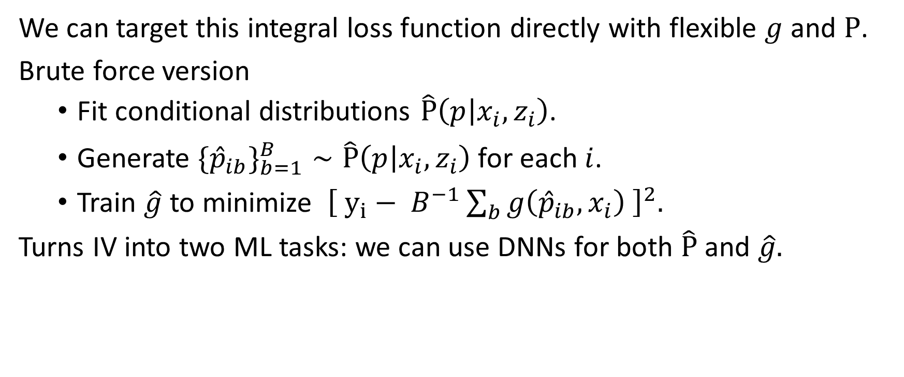

$$\min_{g∈G}{ ∑} {\left(y_{i} −\int{g\left(p,x_{i}\right)dP(p|x_{i},z_{i})} \right)}^{2}$$
We can target this integral loss function directly with flexible $g$ and $P$.
Brute force version
Fit conditional distributions $\hat{P}\left(p | x_{i},z_{i}\right)$.
Generate $\{{\hat{p}}_{ib}\}_{b=1}^{B}∼\hat{P}\left(p | x_{i},z_{i}\right)$for each $i$.
Train $\hat{g}$ to minimize ${\left[ y_{i}− B^{−1}\sum_{b}{g\left({\hat{p}}_{ib},x_{i}\right) }\right]}^{2}.$
Turns IV into two ML tasks: we can use DNNs for both $\hat{P}$ and $\hat{g}.$

Slide 25

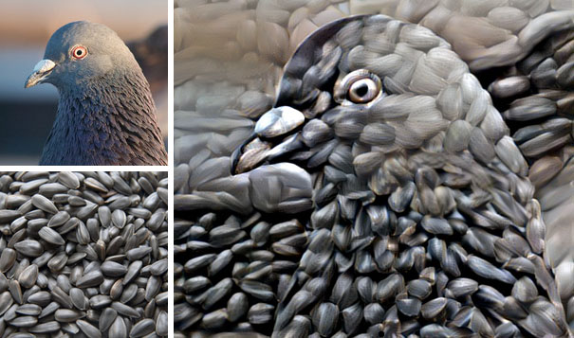
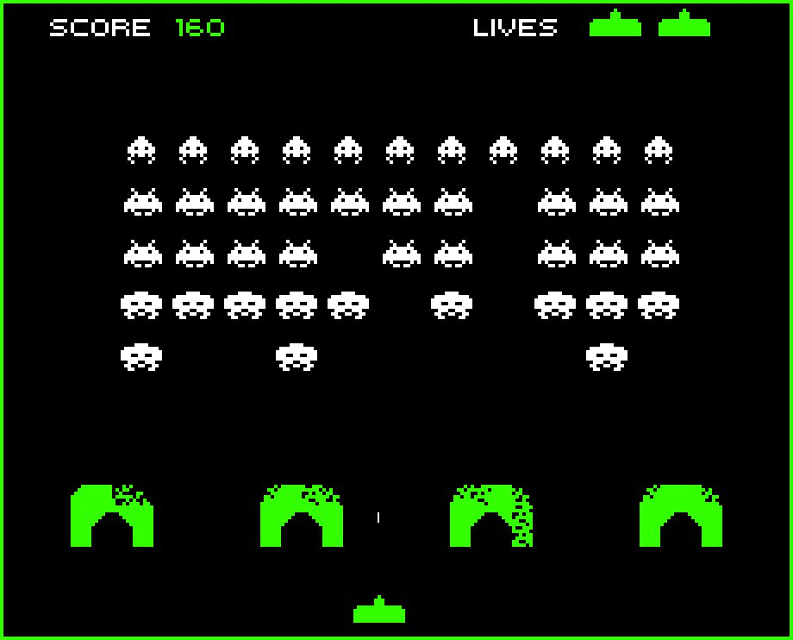
Learning to love Deep Nets

Slide 26
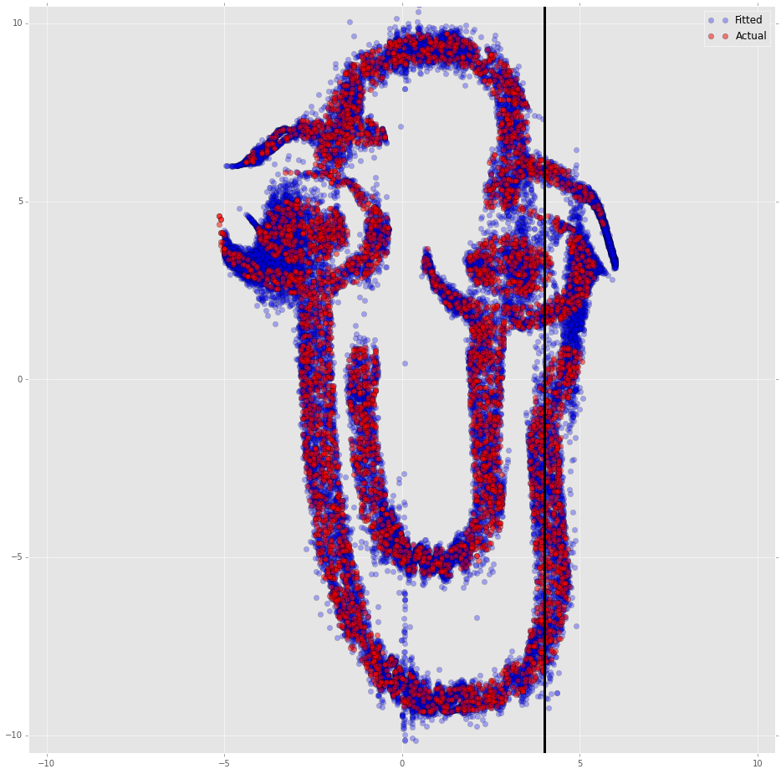
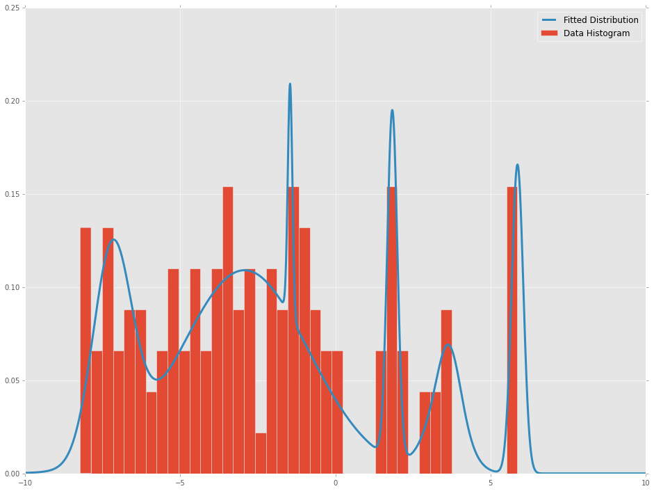

First Stage is out-of-the-box ML: learn $P\left(p | x_{i},z_{i}\right)$
e.g., DNN fits distribution to maximize likelihood for a mixture of Gaussians.

Slide 27
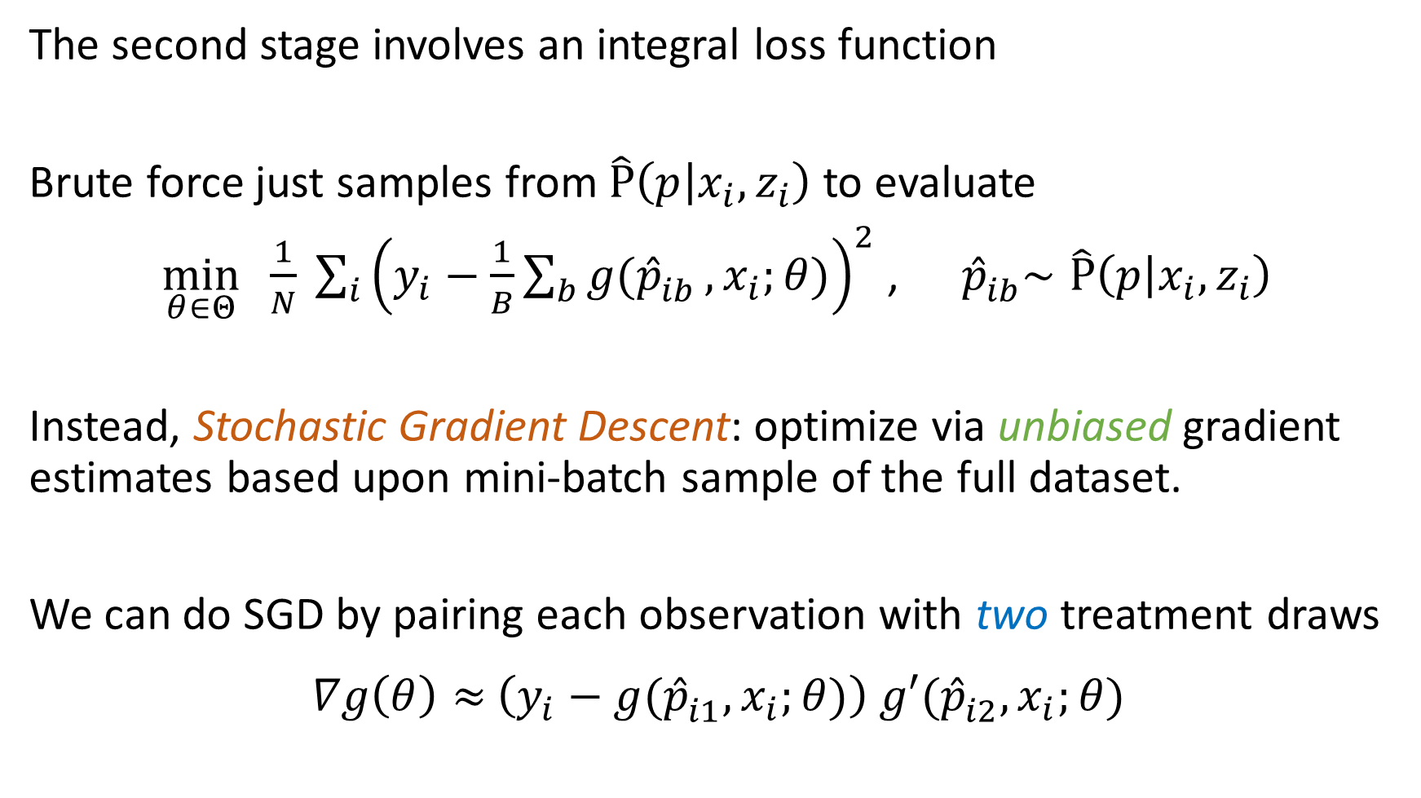
The second stage involves an integral loss function
Brute force just samples from$\hat{P}\left(p | x_{i},z_{i}\right)$ to evaluate
$\min_{θ∈Θ}{ \frac{1}{N} \sum_{i}^{ }{{\left(y_{i}−\frac{1}{B}\sum_{b}{g({\hat{p}}_{ib}^{ }}, x_{i};θ)\right)}^{2}}}$ , ${ \hat{p}}_{ib}^{ }∼\hat{P}\left(p | x_{i},z_{i}\right)$
Instead, Stochastic Gradient Descent: optimize via unbiased gradient estimates based upon mini-batch sample of the full dataset.
We can do SGD by pairing each observation with two treatment draws
$∇g\left(θ\right)≈\left(y_{i}−g({\hat{p}}_{i1}^{ }, x_{i};θ)\right)$ $g′({\hat{p}}_{i2}^{ }, x_{i};θ)$

Slide 28
Linear Demand, Heterogeneous Effects

Slide 29
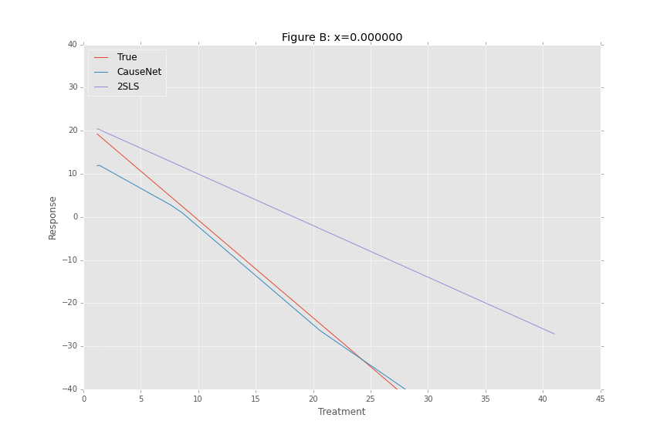
Linear Demand, Heterogeneous Effects

Slide 30
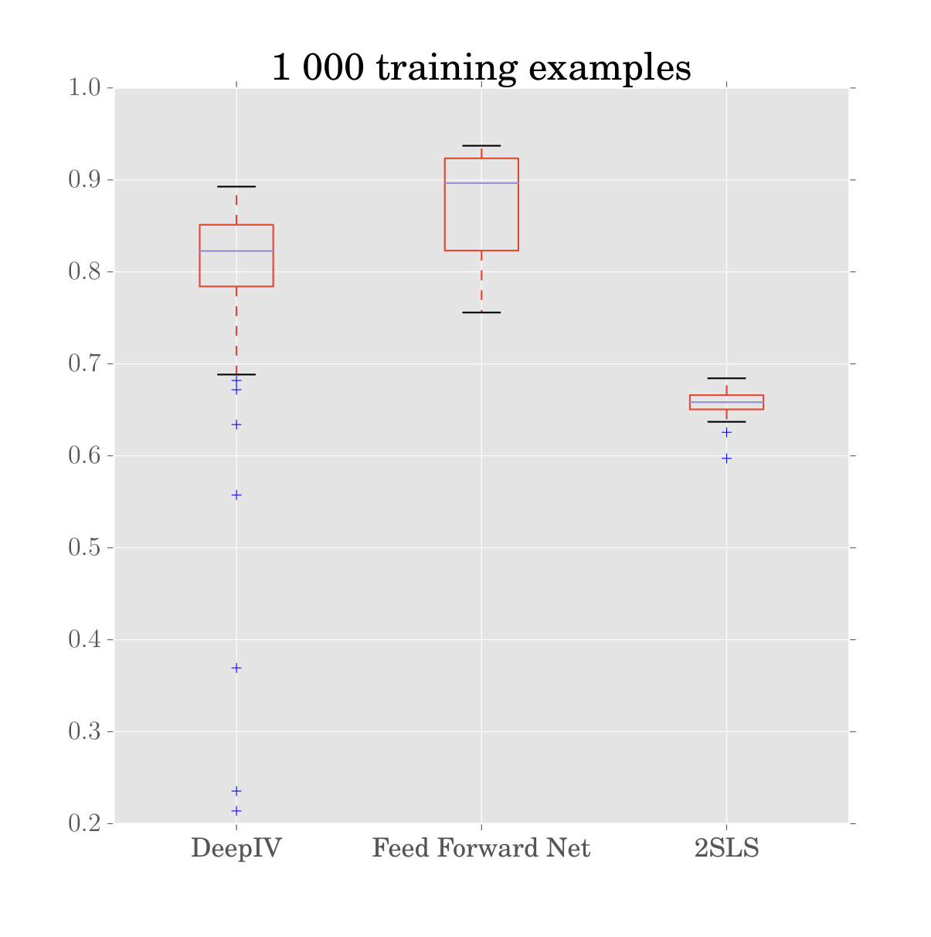
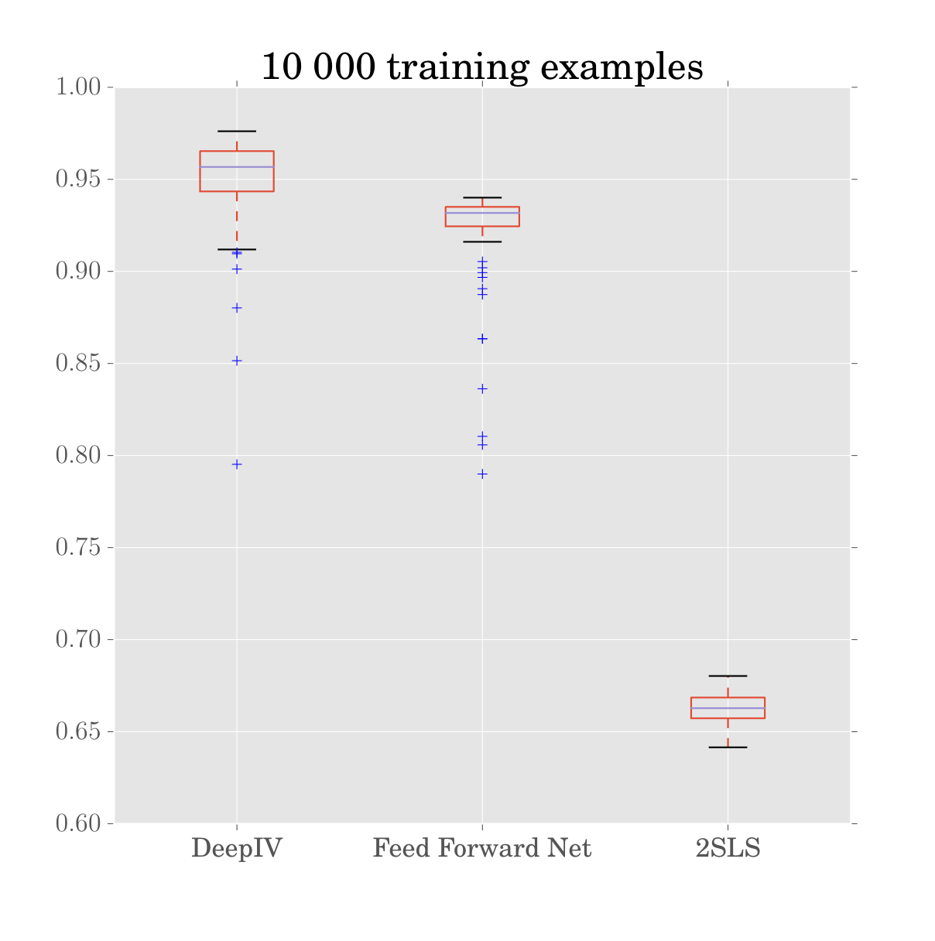
Store Example: R2 Values

Slide 31
Ads Application
Taken from Goldman and Rao (2014)
We have 74 mil click-rates over 4 hour increments for 10k search terms
Treatment: ad position 1-3
Instrument: background AB testing
Covariates: search text and time

Slide 32
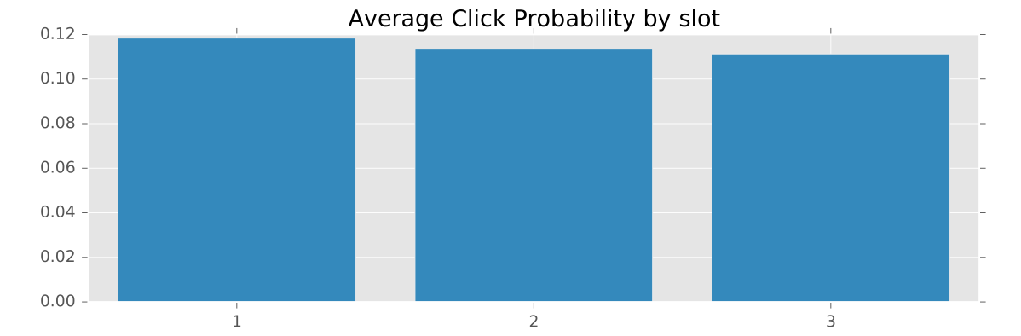
Average Treatment Effects
These compare to observed click probabilities of 0.33, 0.1, and 0.05.

Slide 33
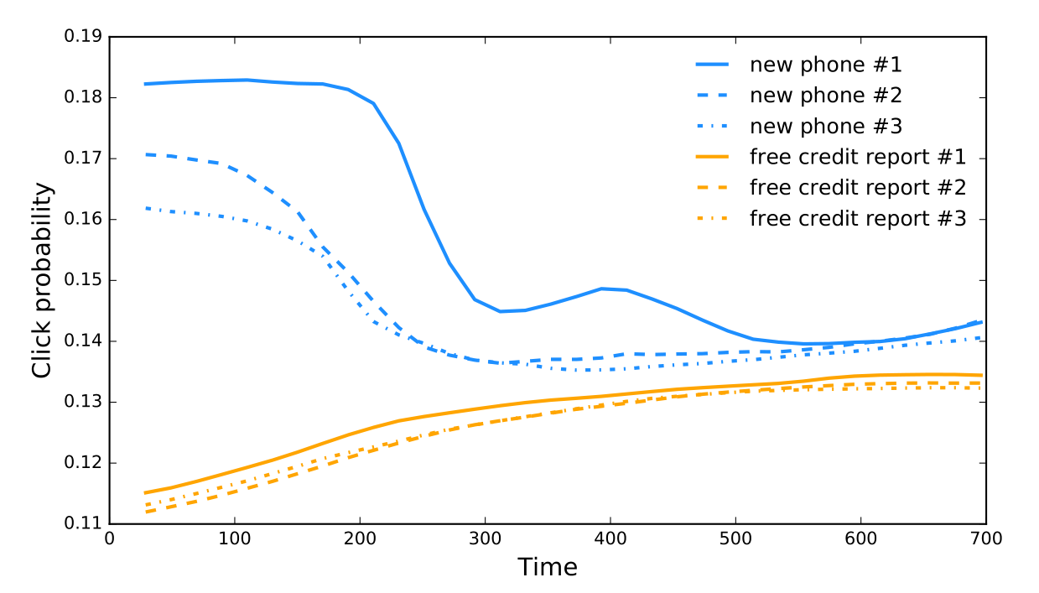
Heterogeneous Treatment Effects

Slide 34
The Econometric Theory Slide
History: Nonlinear IV goes back to Kelejian (1971, JASA) and Amemiya (1974, J Econometrics) for known function g. Choice of efficient instruments requires modeling P(p|x,z).
Newey and Powell (2003, ECMA) extend to unknown g, the “nonparametric” IV case.
They approximate g by an expanding linear basis.
Chen and Pouzo (2012, ECMA) prove consistency results for an expanding (and possibly penalized, non-linear) basis, analyzing penalized sieve minimum distance estimators.
Neural nets are a non-linear basis, so consistency follows from Chen & Pouzo (2012).
Haven’t yet found a result for asymptotic normality.

Slide 35
Economics and Artificial Intelligence
We have a track record pointing ML at questions of science + causation.
We’re going to replicate this success at scale on unstructured data
We use economic theory to build systems of tasks that can be
addressed with Deep nets and other state-of-the-art ML.
This is the construction of systems for Artificial Economic Intelligence.

